Slide 1
Basic Structure of Computers

Slide 2
Functional Units

Slide 3
Functional Units
Arithmetic
Input
and
logic
Memory
Output
Control
I/O
Processor
Figure 1.1. Basic functional units of a computer.

Slide 4
Information Handled by a Computer
Instructions/machine instructions
Govern the transfer of information within a computer as well as between the computer and its I/O devices
Specify the arithmetic and logic operations to be performed
Program
Data
Used as operands by the instructions
Source program
Encoded in binary code – 0 and 1

Slide 5
Memory Unit
Store programs and data
Two classes of storage
Primary storage
Fast
Programs must be stored in memory while they are being executed
Large number of semiconductor storage cells
Processed in words
Address
RAM and memory access time
Memory hierarchy – cache, main memory
Secondary storage – larger and cheaper

Slide 6
Arithmetic and Logic Unit (ALU)
Most computer operations are executed in ALU of the processor.
Load the operands into memory – bring them to the processor – perform operation in ALU – store the result back to memory or retain in the processor.
Registers
Fast control of ALU

Slide 7
Control Unit
All computer operations are controlled by the control unit.
The timing signals that govern the I/O transfers are also generated by the control unit.
Control unit is usually distributed throughout the machine instead of standing alone.
Operations of a computer:
Accept information in the form of programs and data through an input unit and store it in the memory
Fetch the information stored in the memory, under program control, into an ALU, where the information is processed
Output the processed information through an output unit
Control all activities inside the machine through a control unit

Slide 8
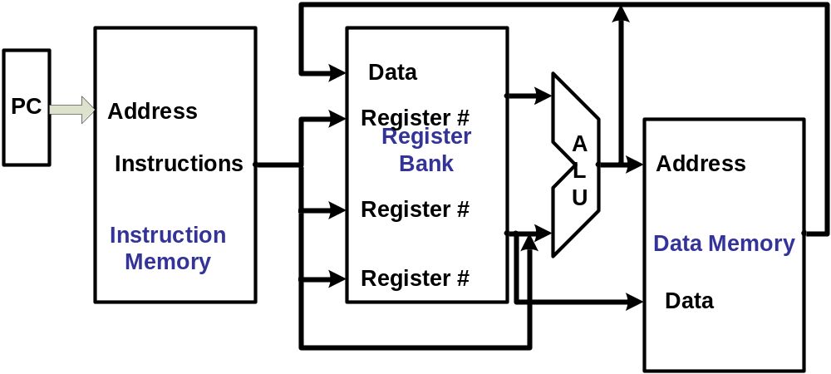
The processor : Data Path and Control
Two types of functional units:
  elements that operate on data values (combinational)
  elements that contain state (state elements)

Slide 9
Five Execution Steps
Step name | Action for R-type instructions | Action for Memory-reference Instructions | Action for branches | Action for jumps
Instruction fetch | IR = MEM[PC] PC = PC + 4
Instruction decode/ register fetch | A = Reg[IR[25-21]] B = Reg[IR[20-16]] ALUOut = PC + (sign extend (IR[15-0])<<2)
Execution, address computation, branch/jump completion | ALUOut = A op B | ALUOut = A+sign extend(IR[15-0]) | IF(A==B) Then PC=ALUOut | PC=PC[31-28]||(IR[25-0]<<2)
Memory access or R-type completion | Reg[IR[15-11]] = ALUOut | Load:MDR =Mem[ALUOut] or Store:Mem[ALUOut] = B
Memory read completion |  | Load: Reg[IR[20-16]] = MDR

Slide 10
Basic Operational Concepts

Slide 11
Review
Activity in a computer is governed by instructions.
To perform a task, an appropriate program consisting of a list of instructions is stored in the memory.
Individual instructions are brought from the memory into the processor, which executes the specified operations.
Data to be used as operands are also stored in the memory.

Slide 12
A Typical Instruction
Add LOCA, R0
Add the operand at memory location LOCA to the operand in a register R0 in the processor.
Place the sum into register R0.
The original contents of LOCA are preserved.
The original contents of R0 is overwritten.
Instruction is fetched from the memory into the processor – the operand at LOCA is fetched and added to the contents of R0 – the resulting sum is stored in register R0.

Slide 13
Separate Memory Access and ALU Operation
Load LOCA, R1
Add R1, R0
Whose contents will be overwritten?

Slide 14
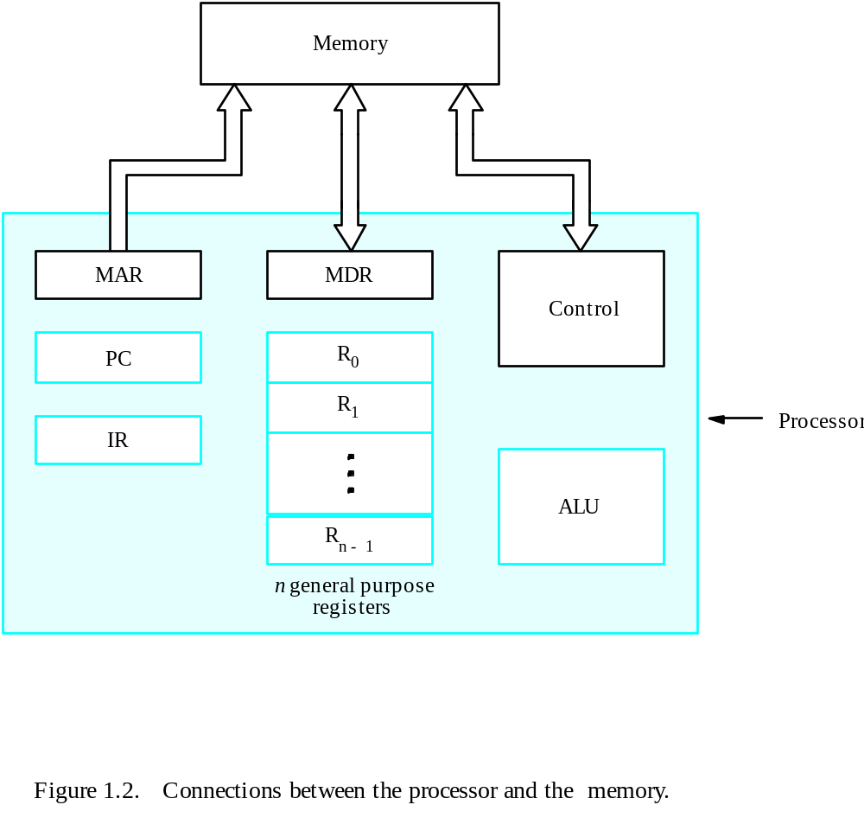
Connection Between the Processor and the Memory

Slide 15
Registers
Instruction register (IR)
Program counter (PC)
General-purpose register (R₀ – R_{n-1})
Memory address register (MAR)
Memory data register (MDR)

Slide 16
Typical Operating Steps
Programs reside in the memory through input devices
PC is set to point to the first instruction
The contents of PC are transferred to MAR
A Read signal is sent to the memory
The first instruction is read out and loaded into MDR
The contents of MDR are transferred to IR
Decode and execute the instruction

Slide 17
Typical Operating Steps (Cont’)
Get operands for ALU
  General-purpose register
  Memory (address to MAR – Read – MDR to ALU)
Perform operation in ALU
Store the result back
  To general-purpose register
  To memory (address to MAR, result to MDR – Write)
During the execution, PC is incremented to the next instruction

Slide 18
Interrupt
Normal execution of programs may be preempted if some device requires urgent servicing.
The normal execution of the current program must be interrupted – the device raises an interrupt signal.
Interrupt-service routine
Current system information backup and restore (PC, general-purpose registers, control information, specific information)

Slide 19
Bus Structures
There are many ways to connect different parts inside a computer together.
A group of lines that serves as a connecting path for several devices is called a bus.
Address/data/control

Slide 20
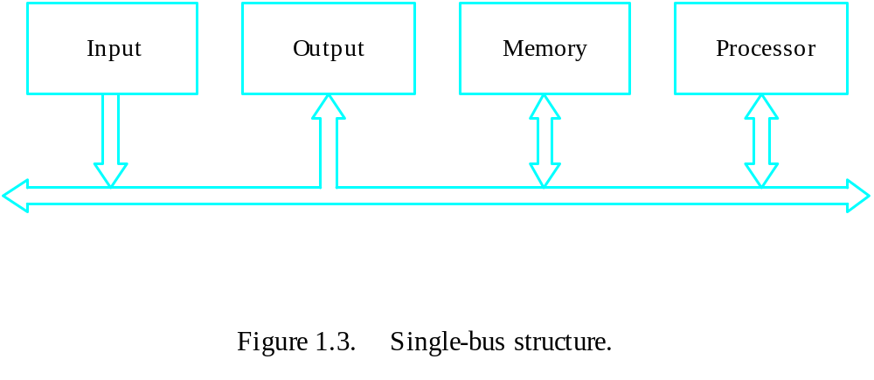
Bus Structure
Single-bus

Slide 21
Speed Issue
Different devices have different transfer/operate speed.
If the speed of bus is bounded by the slowest device connected to it, the efficiency will be very low.
How to solve this?
A common approach – use buffers.

Slide 22
Performance

Slide 23
Performance
The most important measure of a computer is how quickly it can execute programs.
Three factors affect performance:
Hardware design
Instruction set
Compiler

Slide 24
Performance
Processor time to execute a program depends on the hardware involved in the execution of individual machine instructions.
Main
Cache
memory
memory
Processor
Bus
Figure 1.5.
The processor cache.

Slide 25
Performance
The processor and a relatively small cache memory can be fabricated on a single integrated circuit chip.
Speed
Cost
Memory management

Slide 26
Processor Clock
Clock, clock cycle, and clock rate
The execution of each instruction is divided into several steps, each of which completes in one clock cycle.
Hertz – cycles per second

Slide 27
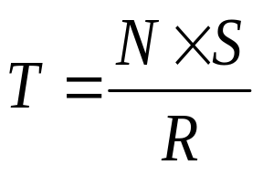
Basic Performance Equation
T – processor time required to execute a program that has been prepared in high-level language
N – number of actual machine language instructions needed to complete the execution (note: loop)
S – average number of basic steps needed to execute one machine instruction. Each step completes in one clock cycle
R – clock rate
Note: these are not independent to each other
How to improve T?

Slide 28
Pipeline and Superscalar Operation
Instructions are not necessarily executed one after another.
The value of S doesn’t have to be the number of clock cycles to execute one instruction.
Pipelining – overlapping the execution of successive instructions.
Add R1, R2, R3
Superscalar operation – multiple instruction pipelines are implemented in the processor.
Goal – reduce S (could become <1!)

Slide 29
Clock Rate
Increase clock rate
Improve the integrated-circuit (IC) technology to make the circuits faster
Reduce the amount of processing done in one basic step (however, this may increase the number of basic steps needed)
Increases in R that are entirely caused by improvements in IC technology affect all aspects of the processor’s operation equally except the time to access the main memory.

Slide 30
CISC and RISC
Tradeoff between N and S
A key consideration is the use of pipelining
S is close to 1 even though the number of basic steps per instruction may be considerably larger
It is much easier to implement efficient pipelining in processor with simple instruction sets
Reduced Instruction Set Computers (RISC)
Complex Instruction Set Computers (CISC)

Slide 31
Compiler
A compiler translates a high-level language program into a sequence of machine instructions.
To reduce N, we need a suitable machine instruction set and a compiler that makes good use of it.
Goal – reduce N×S
A compiler may not be designed for a specific processor; however, a high-quality compiler is usually designed for, and with, a specific processor.

Slide 32
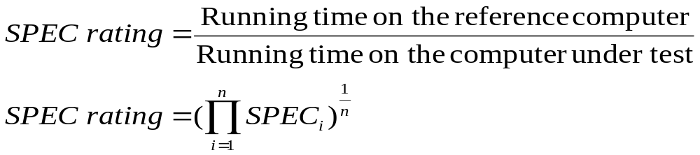
Performance Measurement
T is difficult to compute.
Measure computer performance using benchmark programs.
System Performance Evaluation Corporation (SPEC) selects and publishes representative application programs for different application domains, together with test results for many commercially available computers.
Compile and run (no simulation)
Reference computer

Slide 33
Multiprocessors and Multicomputers
Multiprocessor computer
Execute a number of different application tasks in parallel
Execute subtasks of a single large task in parallel
All processors have access to all of the memory – shared-memory multiprocessor
Cost – processors, memory units, complex interconnection networks
Multicomputers
Each computer only have access to its own memory
Exchange message via a communication network – message-passing multicomputers

Slide 35
Chapter 2. Machine Instructions and Programs

Slide 36
Objectives
Machine instructions and program execution, including branching and subroutine call and return operations.
Number representation and addition/subtraction in the 2’s-complement system.
Addressing methods for accessing register and memory operands.
Assembly language for representing machine instructions, data, and programs.
Program-controlled Input/Output operations.

Slide 37
Number, Arithmetic Operations, and Characters

Slide 38
Signed Integer
3 major representations:
Sign and magnitude
One’s complement
Two’s complement
Assumptions:
4-bit machine word
16 different values can be represented
Roughly half are positive, half are negative

Slide 39
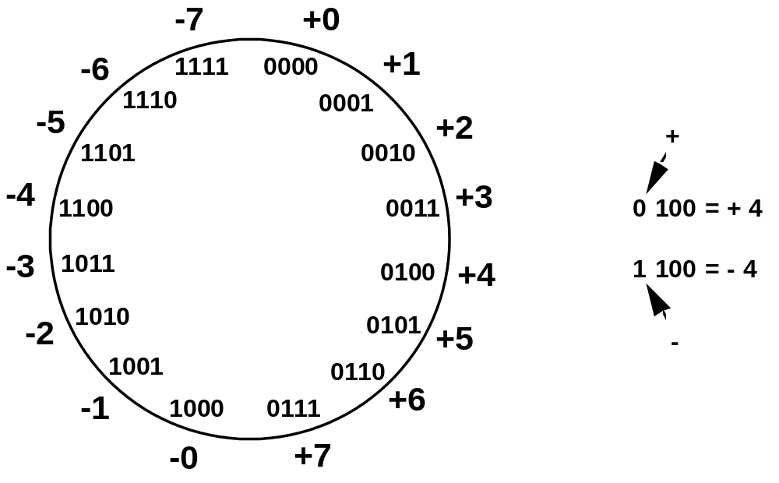
Sign and Magnitude Representation
High order bit is sign: 0 = positive (or zero), 1 = negative
Three low order bits is the magnitude: 0 (000) thru 7 (111)
Number range for n bits = +/-2^{n-1} -1
Two representations for 0

Slide 40
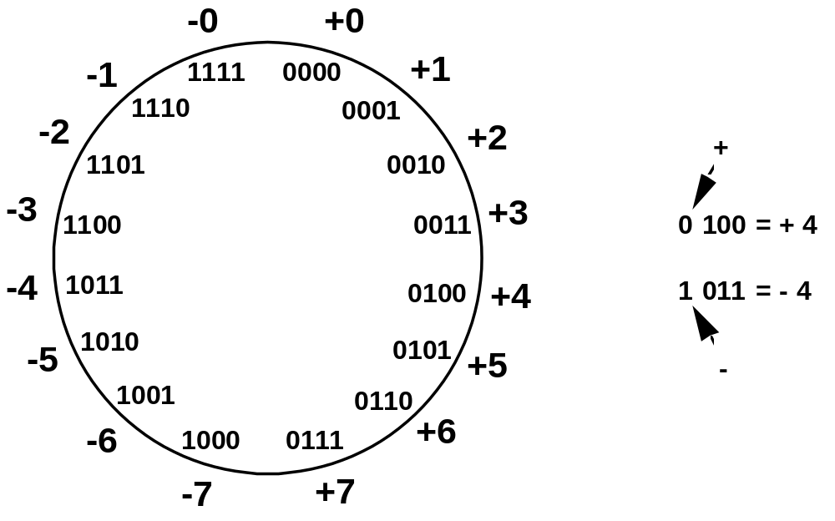
One’s Complement Representation
Subtraction implemented by addition & 1's complement
Still two representations of 0! This causes some problems
Some complexities in addition

Slide 41
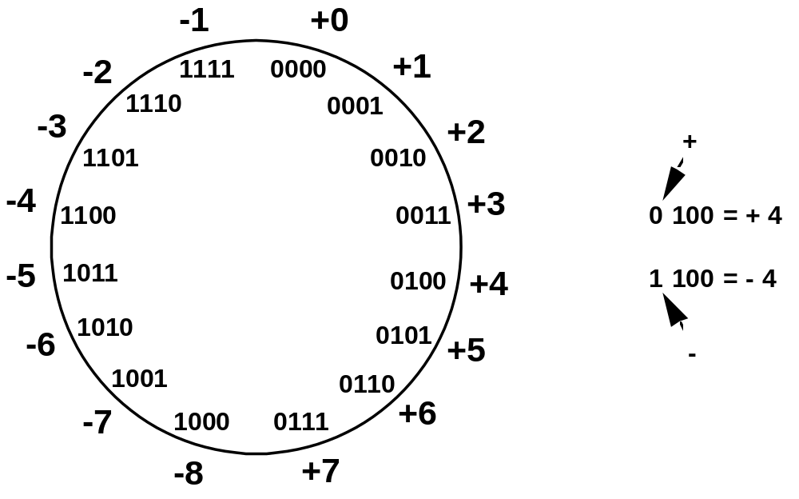
Two’s Complement Representation
like 1's comp
except shifted
one position
clockwise
Only one representation for 0
One more negative number than positive number

Slide 42
Binary, Signed-Integer Representations
Page 28
B
V
alues represented
Sign and
b
3
b
2
b
1
b
0
magnitude
1'
s complement
2'
s complement
0
1
1
1
+
7
+
7
+
7
0
1
1
0
+
6
+
6
+
6
0
1
0
1
+
5
+
5
+
5
0
1
0
0
+
4
+
4
+
4
0
0
1
1
+
3
+
3
+
3
0
0
1
0
+
2
+
2
+
2
0
0
0
1
+
1
+
1
+
1
0
0
0
0
+
0
+
0
+
0
1
0
0
0
-
0
-
7
-
8
1
0
0
1
-
1
-
6
-
7
1
0
1
0
-
2
-
5
-
6
1
0
1
1
-
3
-
4
-
5
1
1
0
0
-
4
-
3
-
4
1
1
0
1
-
5
-
2
-
3
1
1
1
0
-
6
-
1
-
2
1
1
1
1
-
7
-
0
-
1
Figure 2.1. Binary, signed-integer representations.

Slide 43
Addition and Subtraction – 2’s Complement
4
+ 3
7
0100
0011
0111
-4
+ (-3)
-7
1100
1101
11001
If carry-in to the high
order bit =
carry-out then ignore
carry
if carry-in differs from
carry-out then overflow
4
- 3
1
0100
1101
10001
-4
+ 3
-1
1100
0011
1111
Simpler addition scheme makes twos complement the most common
choice for integer number systems within digital systems

Slide 44
2’s-Complement Add and Subtract Operations
(a)
0 0 1 0
(
+
2
)
(b)
0 1 0 0
(
+
4
)
Page 31
+
0 0 1 1
(
+
3
)
+
1 0 1 0
(
-
6
)
0 1 0 1
(
+
5
)
1 1 1 0
(
-
2
)
(c)
1 0 1 1
(
-
5
)
(d)
0 1 1 1
(
+
7
)
+
1 1 1 0
(
-
2
)
+
1 1 0 1
(
-
3
)
1 0 0 1
(
-
7
)
0 1 0 0
(
+
4
)
(e)
1 1 0 1
(
-
3
)
1 1 0 1
-
1 0 0 1
(
-
7
)
+
0 1 1 1
0 1 0 0
(
+
4
)
(f)
0 0 1 0
(
+
2
)
0 0 1 0
-
0 1 0 0
(
+
4
)
+
1 1 0 0
1 1 1 0
(
-
2
)
(g)
0 1 1 0
(
+
6
)
0 1 1 0
-
0 0 1 1
(
+
3
)
+
1 1 0 1
0 0 1 1
(
+
3
)
(h)
1 0 0 1
(
-
7
)
1 0 0 1
-
1 0 1 1
(
-
5
)
+
0 1 0 1
1 1 1 0
(
-
2
)
(i)
1 0 0 1
(
-
7
)
1 0 0 1
-
0 0 0 1
(
+
1
)
+
1 1 1 1
1 0 0 0
(
-
8
)
(j)
0 0 1 0
(
+
2
)
0 0 1 0
-
1 1 0 1
(
-
3
)
+
0 0 1 1
0 1 0 1
(
+
5
)
Figure 2.4. 2's-complement Add and Subtract operations.

Slide 45
Overflow - Add two positive numbers to get a negative number or two negative numbers to get a positive number
-1
+0
-1
+0
-2
1111
0000
+1
-2
1111
0000
+1
-3
1110
0001
-3
1110
0001
1101
+2
1101
+2
-4
0010
-4
0010
1100
0011
+3
1100
0011
+3
-5
1011
-5
0100
+4
1011
0100
+4
-6
1010
-6
1010
0101
+5
0101
+5
1001
0110
1001
0110
-7
1000
+6
-7
+6
0111
1000
0111
-8
+7
-8
+7
5 + 3 = -8
-7 - 2 = +7

Slide 46
Overflow Conditions
0 1 1 1
0 1 0 1
0 0 1 1
1 0 0 0
1 0 0 0
1 0 0 1
1 1 0 0
1 0 1 1 1
5
3
-8
-7
-2
7
Overflow
Overflow
0 0 0 0
0 1 0 1
0 0 1 0
0 1 1 1
1 1 1 1
1 1 0 1
1 0 1 1
1 1 0 0 0
5
2
7
-3
-5
-8
No overflow
No overflow
Overflow when carry-in to the high-order bit does not equal carry out

Slide 47
Sign Extension
Task:
  Given w-bit signed integer x
  Convert it to w+k-bit integer with same value
Rule:
  Make k copies of sign bit:
  X ′ = x_{w–1} ,…, x_{w–1} , x_{w–1} , x_{w–2} ,…, x₀
w
X
• • •
k copies of MSB
• • •
X ′
• • •
• • •
k
w

Slide 48
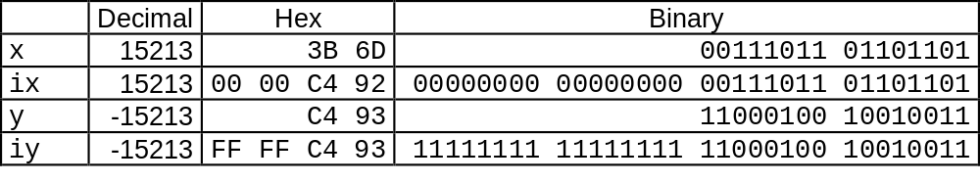
Sign Extension Example
short int x = 15213;
int ix = (int) x;
short int y = -15213;
int iy = (int) y;

Slide 49
Memory Locations, Addresses, and Operations

Slide 50
Memory Location, Addresses, and Operation
n
bits
Memory consists of many millions of storage cells, each of which can store 1 bit.
Data is usually accessed in n-bit groups. n is called word length.
first word
second word
•
•
•
i
th word
•
•
•
last word
Figure 2.5. Memory words.

Slide 51
Memory Location, Addresses, and Operation
32-bit word length example
32 bits
•
•
•
b
31
b
30
b
1
b
0
Sign bit:
b
31
=
0
for positive numbers
b
31
=
1
for negative numbers
(a) A signed integer
8 bits
8 bits
8 bits
8 bits
ASCII
ASCII
ASCII
ASCII
character
character
character
character
(b) Four characters

Slide 52
Memory Location, Addresses, and Operation
To retrieve information from memory, either for one word or one byte (8-bit), addresses for each location are needed.
A k-bit address memory has 2^{k} memory locations, namely 0 – 2^{k}-1, called memory space.
24-bit memory: 2²⁴ = 16,777,216 = 16M (1M=2²⁰)
32-bit memory: 2³² = 4G (1G=2³⁰)
1K(kilo)=2¹⁰
1T(tera)=2⁴⁰

Slide 53
Memory Location, Addresses, and Operation
It is impractical to assign distinct addresses to individual bit locations in the memory.
The most practical assignment is to have successive addresses refer to successive byte locations in the memory – byte-addressable memory.
Byte locations have addresses 0, 1, 2, … If word length is 32 bits, they successive words are located at addresses 0, 4, 8,…

Slide 54
Big-Endian and Little-Endian Assignments
Big-Endian: lower byte addresses are used for the most significant bytes of the word
Little-Endian: opposite ordering. lower byte addresses are used for the less significant bytes of the word
W
ord
address
Byte address
Byte address
0
0
1
2
3
0
3
2
1
0
4
4
5
6
7
4
7
6
5
4
•
•
•
•
•
•
2
k
-
4
2
k
-
4
2
k
-
3
2
k
-
2
2
k
-
1
2
k
-
4
2
k
-
1
2
k
-
2
2
k
-
3
2
k
-
4
(a) Big-endian assignment
(b) Little-endian assignment
Figure 2.7. Byte and word addressing.

Slide 55
Memory Location, Addresses, and Operation
Address ordering of bytes
Word alignment
  Words are said to be aligned in memory if they begin at a byte addr. that is a multiple of the num of bytes in a word.
    16-bit word: word addresses: 0, 2, 4,….
    32-bit word: word addresses: 0, 4, 8,….
    64-bit word: word addresses: 0, 8,16,….
Access numbers, characters, and character strings

Slide 56
Memory Operation
Load (or Read or Fetch)
Copy the content. The memory content doesn’t change.
Address – Load
Registers can be used
Store (or Write)
Overwrite the content in memory
Address and Data – Store
Registers can be used

Slide 57
Instruction and Instruction Sequencing

Slide 58
“Must-Perform” Operations
Data transfers between the memory and the processor registers
Arithmetic and logic operations on data
Program sequencing and control
I/O transfers

Slide 59
Register Transfer Notation
Identify a location by a symbolic name standing for its hardware binary address (LOC, R0,…)
Contents of a location are denoted by placing square brackets around the name of the location (R1←[LOC], R3 ←[R1]+[R2])
Register Transfer Notation (RTN)

Slide 60
Assembly Language Notation
Represent machine instructions and programs.
Move LOC, R1 = R1←[LOC]
Add R1, R2, R3 = R3 ←[R1]+[R2]

Slide 61
CPU Organization
Single Accumulator
  Result usually goes to the Accumulator
  Accumulator has to be saved to memory quite often
General Register
  Registers hold operands thus reduce memory traffic
  Register bookkeeping
Stack
  Operands and result are always in the stack

Slide 62
Instruction Formats
Three-Address Instructions
  ADD R1, R2, R3 R1 ← R2 + R3
Two-Address Instructions
  ADD R1, R2 R1 ← R1 + R2
One-Address Instructions
  ADD M AC ← AC + M[AR]
Zero-Address Instructions
  ADD TOS ← TOS + (TOS – 1)
RISC Instructions
  Lots of registers. Memory is restricted to Load & Store
Instruction
Opcode
Operand(s) or Address(es)

Slide 63
Instruction Formats
Example: Evaluate (A+B) ∗ (C+D)
Three-Address
  ADD R1, A, B ; R1 ← M[A] + M[B]
  ADD R2, C, D ; R2 ← M[C] + M[D]
  MUL X, R1, R2 ; M[X] ← R1 ∗ R2

Slide 64
Instruction Formats
Example: Evaluate (A+B) ∗ (C+D)
Two-Address
  MOV R1, A ; R1 ← M[A]
  ADD R1, B ; R1 ← R1 + M[B]
  MOV R2, C ; R2 ← M[C]
  ADD R2, D ; R2 ← R2 + M[D]
  MUL R1, R2 ; R1 ← R1 ∗ R2
  MOV X, R1 ; M[X] ← R1

Slide 65
Instruction Formats
Example: Evaluate (A+B) ∗ (C+D)
One-Address
  LOAD A ; AC ← M[A]
  ADD B ; AC ← AC + M[B]
  STORE T ; M[T] ← AC
  LOAD C ; AC ← M[C]
  ADD D ; AC ← AC + M[D]
  MUL T ; AC ← AC ∗ M[T]
  STORE X ; M[X] ← AC

Slide 66
Instruction Formats
Example: Evaluate (A+B) ∗ (C+D)
Zero-Address
  PUSH A ; TOS ← A
  PUSH B ; TOS ← B
  ADD ; TOS ← (A + B)
  PUSH C ; TOS ← C
  PUSH D ; TOS ← D
  ADD ; TOS ← (C + D)
  MUL ; TOS ← (C+D)∗(A+B)
  POP X ; M[X] ← TOS

Slide 67
Instruction Formats
Example: Evaluate (A+B) ∗ (C+D)
RISC
  LOAD R1, A ; R1 ← M[A]
  LOAD R2, B ; R2 ← M[B]
  LOAD R3, C ; R3 ← M[C]
  LOAD R4, D ; R4 ← M[D]
  ADD R1, R1, R2 ; R1 ← R1 + R2
  ADD R3, R3, R4 ; R3 ← R3 + R4
  MUL R1, R1, R3 ; R1 ← R1 ∗ R3
  STORE X, R1 ; M[X] ← R1

Slide 68
Using Registers
Registers are faster
Shorter instructions
  The number of registers is smaller (e.g. 32 registers need 5 bits)
Potential speedup
Minimize the frequency with which data is moved back and forth between the memory and processor registers.

Slide 69
Instruction Execution and Straight-Line Sequencing
Address
Contents
Assumptions:
- One memory operand
per instruction
- 32-bit word length
- Memory is byte
addressable
- Full memory address
can be directly specified
in a single-word instruction
Begin execution here
i
Move
A,R0
3-instruction
i
+ 4
Add
B,R0
program
segment
i
+ 8
Move
R0,C
A
B
Data for
the program
Two-phase procedure
Instruction fetch
Instruction execute
C
Page 43
Figure 2.8. A program for C ← [Α] + [Β].

Slide 70
Branching
i
Move
NUM1,R0
i
+
4
Add
NUM2,R0
i
+
8
Add
NUM3,R0
•
•
•
i
+
4
n
-
4
Add
NUM
n
,R0
i
+
4
n
Move
R0,SUM
•
•
•
SUM
NUM1
NUM2
•
•
•
NUM
n
Figure 2.9. A straight-line program for adding n numbers.

Slide 71
Branching
Move
N,R1
Clear
R0
LOOP
Determine address of
"Next" number and add
Program
"Next" number to R0
loop
Decrement
R1
Branch target
Branch>0
LOOP
Move
R0,SUM
Conditional branch
•
•
•
SUM
N
n
NUM1
Figure 2.10. Using a loop to add n numbers.
NUM2
•
•
•
NUM
n

Slide 72
Condition Codes
Condition code flags
Condition code register / status register
N (negative)
Z (zero)
V (overflow)
C (carry)
Different instructions affect different flags

Slide 73
Conditional Branch Instructions
A: 1 1 1 1 0 0 0 0
Example:
  A: 1 1 1 1 0 0 0 0
  B: 0 0 0 1 0 1 0 0
+(−B): 1 1 1 0 1 1 0 0
1 1 0 1 1 1 0 0
C = 1
Z = 0
S = 1
V = 0

Slide 74

Status Bits
C_{n-1}
A
B
C_{n}
ALU
F
V
Z
S
C
F_{n-1}
Zero Check

Slide 75
Addressing Modes

Slide 76
Generating Memory Addresses
How to specify the address of branch target?
Can we give the memory operand address directly in a single Add instruction in the loop?
Use a register to hold the address of NUM1; then increment by 4 on each pass through the loop.

Slide 77
Addressing Modes
Implied
  AC is implied in “ADD M[AR]” in “One-Address” instr.
  TOS is implied in “ADD” in “Zero-Address” instr.
Immediate
  The use of a constant in “MOV R1, 5”, i.e. R1 ← 5
Register
  Indicate which register holds the operand
Instruction
Opcode
Mode
...

Slide 78
Addressing Modes
Register Indirect
  Indicate the register that holds the number of the register that holds the operand
    MOV R1, (R2)
Autoincrement / Autodecrement
  Access & update in 1 instr.
Direct Address
  Use the given address to access a memory location
R1
R2 = 3
R3 = 5

Slide 79
Addressing Modes
Indirect Address
  Indicate the memory location that holds the address of the memory location that holds the data
Memory
AR = 101
100
101
0 1 0 4
102
103
104
1 1 0 A

Slide 80
Addressing Modes
Memory
Relative Address
  EA = PC + Relative Addr
0
1
Program
PC = 2
2
+
100
Data
AR = 100
101
102
1 1 0 A
Could be Positive or Negative
(2’s Complement)
103
104

Slide 81
Addressing Modes
Indexed
  EA = Index Register + Relative Addr
Memory
Useful with “Autoincrement” or “Autodecrement”
XR = 2
+
100
AR = 100
101
Could be Positive or Negative
(2’s Complement)
102
1 1 0 A
103
104

Slide 82
Addressing Modes
Base Register
  EA = Base Register + Relative Addr
Memory
Could be Positive or Negative
(2’s Complement)
AR = 2
+
100
0 0 0 5
BR = 100
101
0 0 1 2
102
0 0 0 A
Usually points to the beginning of an array
103
0 1 0 7
104
0 0 5 9

Slide 83
Addressing Modes
Name
Assem
bler
syn
tax
Addressing
function
The different ways in which the location of an operand is specified in an instruction are referred to as addressing modes.
Immediate
#V
alue
Op
erand
=
V
alue
Register
R
i
EA
=
R
i
Absolute
(Direct)
LOC
EA
=
LOC
Indirect
(R
i
)
EA
=
[R
i
]
(LOC)
EA
=
[LOC]
Index
X(R
i
)
EA
=
[R
i
]
+
X
Base
with
index
(R
i
,R
j
)
EA
=
[R
i
]
+
[R
j
]
Base
with
index
X(R
i
,R
j
)
EA
=
[R
i
]
+
[R
j
]
+
X
and
offset
Relative
X(PC)
EA
=
[PC]
+
X
Autoincremen
t
(R
i
)+
EA
=
[R
i
]
;
Incremen
t
R
i
Autodecrement
−
(R
i
)
Decremen
t
R
i
;
EA
=
[R
i
]

Slide 84
Indexing and Arrays
Index mode – the effective address of the operand is generated by adding a constant value to the contents of a register.
Index register
X(R_{i}): EA = X + [R_{i}]
The constant X may be given either as an explicit number or as a symbolic name representing a numerical value.
If X is shorter than a word, sign-extension is needed.

Slide 85
Indexing and Arrays
In general, the Index mode facilitates access to an operand whose location is defined relative to a reference point within the data structure in which the operand appears.
Several variations:
(R_{i}, R_{j}): EA = [R_{i}] + [R_{j}]
X(R_{i}, R_{j}): EA = X + [R_{i}] + [R_{j}]

Slide 86
Relative Addressing
Relative mode – the effective address is determined by the Index mode using the program counter in place of the general-purpose register.
X(PC) – note that X is a signed number
Branch>0 LOOP
This location is computed by specifying it as an offset from the current value of PC.
Branch target may be either before or after the branch instruction, the offset is given as a singed num.

Slide 87
Additional Modes
Autoincrement mode – the effective address of the operand is the contents of a register specified in the instruction. After accessing the operand, the contents of this register are automatically incremented to point to the next item in a list.
(R_{i})+. The increment is 1 for byte-sized operands, 2 for 16-bit operands, and 4 for 32-bit operands.
Autodecrement mode: -(R_{i}) – decrement first
Move
N,R1
Move
#NUM1,R2
Initialization
Clear
R0
LOOP
Add
(R2)+,R0
Decrement
R1
Branch>0
LOOP
Move
R0,SUM
Figure 2.16. The Autoincrement addressing mode used in the program of Figure 2.12.

Slide 88
Assembly Language

Slide 89
Types of Instructions
Data Transfer Instructions
Name | Mnemonic
Load | LD
Store | ST
Move | MOV
Exchange | XCH
Input | IN
Output | OUT
Push | PUSH
Pop | POP
Data value is not modified

Slide 90
Data Transfer Instructions
Mode | Assembly | Register Transfer
Direct address | LD ADR | AC ← M[ADR]
Indirect address | LD @ADR | AC ← M[M[ADR]]
Relative address | LD $ADR | AC ← M[PC+ADR]
Immediate operand | LD #NBR | AC ← NBR
Index addressing | LD ADR(X) | AC ← M[ADR+XR]
Register | LD R1 | AC ← R1
Register indirect | LD (R1) | AC ← M[R1]
Autoincrement | LD (R1)+ | AC ← M[R1], R1 ← R1+1

Slide 91
Data Manipulation Instructions
Arithmetic
Logical & Bit Manipulation
Shift
Name | Mnemonic
Increment | INC
Decrement | DEC
Add | ADD
Subtract | SUB
Multiply | MUL
Divide | DIV
Add with carry | ADDC
Subtract with borrow | SUBB
Negate | NEG
Name | Mnemonic
Clear | CLR
Complement | COM
AND | AND
OR | OR
Exclusive-OR | XOR
Clear carry | CLRC
Set carry | SETC
Complement carry | COMC
Enable interrupt | EI
Disable interrupt | DI
Name | Mnemonic
Logical shift right | SHR
Logical shift left | SHL
Arithmetic shift right | SHRA
Arithmetic shift left | SHLA
Rotate right | ROR
Rotate left | ROL
Rotate right through carry | RORC
Rotate left through carry | ROLC

Slide 92
Program Control Instructions
Name | Mnemonic
Branch | BR
Jump | JMP
Skip | SKP
Call | CALL
Return | RET
Compare (Subtract) | CMP
Test (AND) | TST
Subtract A – B but don’t store the result
1
0
1
1
0
0
0
1
0
0
0
0
1
0
0
0
Mask
0
0
0
0
0
0
0
0

Slide 93
Conditional Branch Instructions
Mnemonic | Branch Condition | Tested Condition
BZ | Branch if zero | Z = 1
BNZ | Branch if not zero | Z = 0
BC | Branch if carry | C = 1
BNC | Branch if no carry | C = 0
BP | Branch if plus | S = 0
BM | Branch if minus | S = 1
BV | Branch if overflow | V = 1
BNV | Branch if no overflow | V = 0

Slide 94
Basic Input/Output Operations

Slide 95
I/O
The data on which the instructions operate are not necessarily already stored in memory.
Data need to be transferred between processor and outside world (disk, keyboard, etc.)
I/O operations are essential, the way they are performed can have a significant effect on the performance of the computer.

Slide 96
Program-Controlled I/O Example
Read in character input from a keyboard and produce character output on a display screen.
Rate of data transfer (keyboard, display, processor)
Difference in speed between processor and I/O device creates the need for mechanisms to synchronize the transfer of data.
A solution: on output, the processor sends the first character and then waits for a signal from the display that the character has been received. It then sends the second character. Input is sent from the keyboard in a similar way.

Slide 97
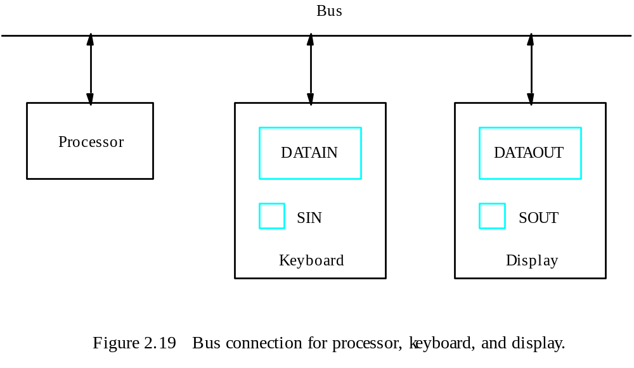
Program-Controlled I/O Example
- Registers
Flags
- Device interface

Slide 98
Program-Controlled I/O Example
Machine instructions that can check the state of the status flags and transfer data:
READWAIT Branch to READWAIT if SIN = 0
Input from DATAIN to R1
WRITEWAIT Branch to WRITEWAIT if SOUT = 0
Output from R1 to DATAOUT

Slide 99
Program-Controlled I/O Example
Memory-Mapped I/O – some memory address values are used to refer to peripheral device buffer registers. No special instructions are needed. Also use device status registers.
READWAIT Testbit #3, INSTATUS
Branch=0 READWAIT
MoveByte DATAIN, R1

Slide 100
Program-Controlled I/O Example
Assumption – the initial state of SIN is 0 and the initial state of SOUT is 1.
Any drawback of this mechanism in terms of efficiency?
  Two wait loops→processor execution time is wasted
Alternate solution?
  Interrupt

Slide 101
Stacks

Slide 102
Home Work
For each Addressing modes mentioned before, state one example for each addressing mode stating the specific benefit for using such addressing mode for such an application.

Slide 103
Stack Organization
DR
Current
Top of Stack
TOS
LIFO
  Last In First Out
0
1
2
3
4
5
SP
6
0 1 2 3
7
0 0 5 5
FULL
EMPTY
8
0 0 0 8
9
0 0 2 5
Stack Bottom
10
0 0 1 5
Stack

Slide 104
Stack Organization
DR
Current
Top of Stack
TOS
Current
Top of Stack
TOS
1 6 9 0
PUSH
  SP ← SP – 1
  M[SP] ← DR
  If (SP = 0) then (FULL ← 1)
  EMPTY ← 0
0
1
2
3
4
5
1 6 9 0
SP
6
0 1 2 3
7
0 0 5 5
FULL
EMPTY
8
0 0 0 8
9
0 0 2 5
Stack Bottom
10
0 0 1 5
Stack

Slide 105
Stack Organization
DR
Current
Top of Stack
TOS
Current
Top of Stack
TOS
POP
  DR ← M[SP]
  SP ← SP + 1
  If (SP = 11) then (EMPTY ← 1)
  FULL ← 0
0
1
2
3
4
5
1 6 9 0
1 6 9 0
SP
6
0 1 2 3
7
0 0 5 5
FULL
EMPTY
8
0 0 0 8
9
0 0 2 5
Stack Bottom
10
0 0 1 5
Stack

Slide 106
Stack Organization
Memory Stack
  PUSH
    SP ← SP – 1
    M[SP] ← DR
  POP
    DR ← M[SP]
    SP ← SP + 1
Memory
PC
0
1
Program
2
AR
100
101
Data
102
200
SP
201
Stack
202

Slide 107
Reverse Polish Notation
Infix Notation
  A + B
Prefix or Polish Notation
  + A B
Postfix or Reverse Polish Notation (RPN)
  A B +
(2) (4) ∗ (3) (3) ∗ +
(8) (3) (3) ∗ +
(8) (9) +
17
RPN
A ∗ B + C ∗ D
A B ∗ C D ∗ +

Slide 108
Reverse Polish Notation
Example
  (A + B) ∗ [C ∗ (D + E) + F]
(A B +)
(D E +)
C ∗
F +
∗

Slide 109
Reverse Polish Notation
Stack Operation
  (3) (4) ∗ (5) (6) ∗ +
PUSH 3
PUSH 4
MULT
PUSH 5
PUSH 6
MULT
ADD
6
4
5
30
3
12
42

Slide 110
Additional Instructions

Slide 111
Logical Shifts
Logical shift – shifting left (LShiftL) and shifting right (LShiftR)
C
R0
0
before:
0
0
1
1
1
0
.
.
.
0
1
1
after:
1
1
1
0
.
.
.
0
1
1
0
0
(a) Logical shift left
LShiftL #2,R0
0
R0
C
before:
0
1
1
1
0
.
.
.
0
1
1
0
after:
0
0
0
1
1
1
0
.
.
.
0
1
(b) Logical shift r
ight
LShiftR #2,R0

Slide 112
Arithmetic Shifts
R0
C
before:
1
0
0
1
1
.
.
.
0
1
0
0
after:
1
1
1
0
0
1
1
.
.
.
0
1
(c) Ar
ithmetic shift r
ight
AShiftR #2,R0

Slide 113
Rotate
C
R0
before:
0
0
1
1
1
0
.
.
.
0
1
1
after:
1
1
1
0
.
.
.
0
1
1
0
1
(a) Rotate left without carr
y
RotateL #2,R0
C
R0
before:
0
0
1
1
1
0
.
.
.
0
1
1
after:
1
1
1
0
.
.
.
0
1
1
0
0
(b) Rotate left with carr
y
RotateLC #2,R0
R0
C
before:
0
1
1
1
0
.
.
.
0
1
1
0
after:
1
1
0
1
1
1
0
.
.
.
0
1
(c) Rotate r
ight without carr
y
RotateR #2,R0
R0
C
before:
0
1
1
1
0
.
.
.
0
1
1
0
after:
1
0
0
1
1
1
0
.
.
.
0
1
(d) Rotate r
ight with carr
y
RotateRC #2,R0
Figure 2.32. Rotate instructions.

Slide 114
Multiplication and Division
Not very popular (especially division)
Multiply R_{i}, R_{j}
R_{j} ← [R_{i}] х [R_{j}]
2n-bit product case: high-order half in R(j+1)
Divide R_{i}, R_{j}
R_{j} ← [R_{i}] / [R_{j}]
  Quotient is in Rj, remainder may be placed in R(j+1)

Slide 115
Encoding of Machine Instructions

Slide 116
Encoding of Machine Instructions
Assembly language program needs to be converted into machine instructions. (ADD = 0100 in ARM instruction set)
In the previous section, an assumption was made that all instructions are one word in length.
OP code: the type of operation to be performed and the type of operands used may be specified using an encoded binary pattern
Suppose 32-bit word length, 8-bit OP code (how many instructions can we have?), 16 registers in total (how many bits?), 3-bit addressing mode indicator.
Add R1, R2
Move 24(R0), R5
LshiftR #2, R0
Move #$3A, R1
Branch>0 LOOP
8
7
7
10
OP code
Source
Dest
Other info
(a) One-word instruction

Slide 117
Encoding of Machine Instructions
What happens if we want to specify a memory operand using the Absolute addressing mode?
Move R2, LOC
14-bit for LOC – insufficient
Solution – use two words
OP code
Source
Dest
Other info
Memory address/Immediate operand
(b) Two-word instruction

Slide 118
Encoding of Machine Instructions
Then what if an instruction in which two operands can be specified using the Absolute addressing mode?
Move LOC1, LOC2
Solution – use two additional words
This approach results in instructions of variable length. Complex instructions can be implemented, closely resembling operations in high-level programming languages – Complex Instruction Set Computer (CISC)

Slide 119
Encoding of Machine Instructions
If we insist that all instructions must fit into a single 32-bit word, it is not possible to provide a 32-bit address or a 32-bit immediate operand within the instruction.
It is still possible to define a highly functional instruction set, which makes extensive use of the processor registers.
Add R1, R2 ----- yes
Add LOC, R2 ----- no
Add (R3), R2 ----- yes

